Slide 1
Relational Model

Slide 2
Relational Model
The first database systems were based on the network and hierarchical models
Relational Model was proposed by Edgar. F. Codd (1923-2003) in the early seventies.
Most of the modern DBMS are relational.
Simple and elegant model with a mathematical basis.
Led to the development of a theory of data dependencies and database design.
Relational algebra operations –
crucial role in query optimization and execution.
Laid the foundation for the development of
Tuple relational calculus and then
Database standard SQL

Slide 3
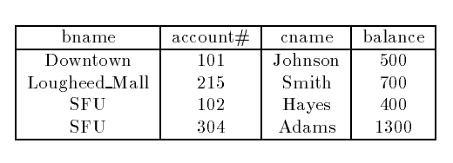
Basic structure
It has four attributes.
For each attribute there is a permitted set of values, called the domain of that attribute.
E.g. the domain of bname is the set of all branch names.
Let D1 denote the domain of bname, and D2, D3 and D₄the remaining attributes' domains respectively.
Then, any row of deposit consists of a four-tuple v₁;v2;v3;v4 where
v₁E D1;v2 E D2;v3 E D3;v4 E D4

Slide 4


In general, deposit contains a subset of the set of all possible rows.
That is, deposit is a subset of D₁ X D2XD3XD4; or; abbreviated to;
In general, a table of n columns must be a subset of
all possible rows
Mathematicians define a relation to be a subset of a Cartesian product of a list of domains
We will use the terms relation and tuple in place of table and row from now on.

Slide 5
let the tuple variable t refer to a tuple of the relation r.
We say t E r to denote that the tuple t is in relation r.
Then t[bname] = t[1] = the value of t on the bname attribute.
So t[bname] = t[1] = “Downtown",
and t[cname] = t[3] = “Johnson".

Slide 6
Relational Moel
Tables are called as relation.
Column headers are known as attributes.
Rows are called as tuples
Relation schema = name(attributes) + other structure information
E.g., keys, other constraints.
Order of attributes is arbitrary, but in practice we need to assume the order given in the relation schema.
Relation instance is current set of rows for a relation schema.
Database schema = collection of relation schemas.

Slide 7
Basic Structure
Formally, given sets D1, D2,... Dn a relation r is a subset of D1x D2x … x Dn .Thus a relation is a set of n-tuples (a1, a2, …, an) where each ai Di
Example: if
customer-name = {Jones, Smith, Curry, Lindsay}
customer-street = {Main, North, Park}
customer-city = {Harrison, Rye, Pittsfield}
Then r = {
(Jones, Main, Harrison),
(Smith, North, Rye),
(Curry, North, Rye),
(Lindsay, Park, Pittsfield)}
is a relation over customer-name x customer-street x customer-city

Slide 8
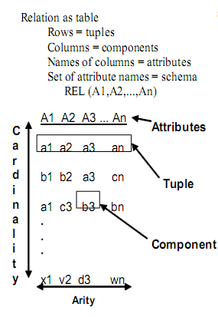
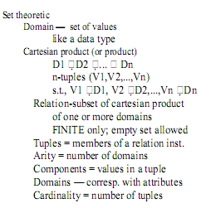

Slide 9
Query Language
is a language in which a user requests information from a database.
These are typically
Procedural, where the user instructs the system to perform a sequence of operations on the database. This will compute the desired information.
Nonprocedural, where the user specifies the information desired without giving a procedure for obtaining the information.
A complete query language also contains facilities to insert and delete tuples as well as to modify parts of existing tuples.

Slide 10
RELATIONAL ALGEBRA
A set of operators (unary and binary) that take relation instances as arguments and return new relations.
Gives a procedural method of specifying a retrieval query.
Forms the core component of a relational query engine.
SQL queries are internally translated into RA expressions.
Provides a framework for query optimization.

Slide 11
RA Operations
Six basic operators are fundamental in relational algebra.
They are
select (σ),
project (π),
cross product (×),
union (⋃),
intersection (∩),
difference (−),
join ( ⋈)
The operators take two or more relations as inputs and give a new relation as a result.

Slide 12
The select Operator
Unary operator.
can be used to select those tuples of a relation that
satisfy a given condition (predicate).
Select is denoted by a lowercase Greek sigma, with the predicate appearing as a subscript.
Notation: σθ ( r )
σ : select operator ( read as sigma)
θ : selection condition
r : relation name
Result: a relation with the same schema as r consisting of the tuples in r that satisfy condition θ

Slide 13

Examples of Select Operator
1. Obtain information about a professor with name “giridhar”
σname = “giridhar” (professor)
2. Obtain information about professors who joined the university between 1980 and 1985
σstartYear ≥ 1980 ^ startYear < 1985 (professor)
3. Suppose there is one more relation, client with the scheme
Client scheme = (cname,banker)
We might write
to find clients who have the same name as their banker.

Slide 14

The Project Operation
Project copies its argument relation for the specified attributes only. Since a relation is a set, duplicate rows are eliminated. Projection is denoted by the Greek capital letter pi.
For example, to obtain a relation showing customers and branches, but ignoring amount and loan,

Slide 15

To get the names of customers having the same name as their bankers,
Think of select as taking rows of a relation, and project as taking columns of a relation.

Slide 16


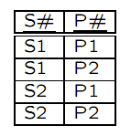
The Cartesian Product Operation
The Cartesian product of two relations is denoted by a cross X written as
r1 X r2 for relations r1 & r2
The result is a new relation with a tuple for each possible pairing of tuples from r1 and r₂.
r X s
Here r and s share no common attribute names
What happens when r and s do share common properties ?

Slide 17
The Cartesian Product Operation
For example, T1(A,B) X T2(B,C)
By the very definition, We get new relation with T3(A,B,B,C) where the two B’s have same name but different values.
What we will do is thus renaming such attributes. This operator, not a basic one, can take the following syntax: expression[A1, · · · ,An]
where A1, · · · ,An are the new names of the original relational expression, for the corresponding positions.

Slide 18

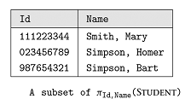

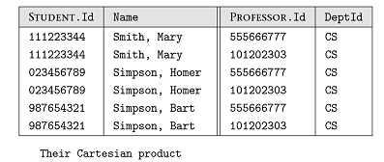
Example of Cartesian Product

Slide 19


Rename Operator
rename operator, denoted by the Greek letter rho
Suppose we want to find the names of all the customers who live on the same street and in the same city as Smith.
To find other customers with the same information, we need to reference the customer relation again

Slide 20

If we use this to rename one of the two customer relations we are using, the ambiguities will disappear.
We are renaming to cust2.

Slide 21
The Union Operation
The union operation is denoted U as in set theory. It returns the union set union of two compatible relations.
For a union operation r U s to be legal, we require that
r and s must have the same number of attributes.
The domains of the corresponding attributes must be the same.

Slide 22
The Union Operation
To find all customers of the SFU branch, we must find everyone who has a loan or an account or both at the branch. We need both borrow and deposit relations for this
As in all set operations, duplicates are eliminated

Slide 23
The Set Difference Operation
Set difference is denoted by the minus sign (-)
It finds tuples that are in one relation, but not in another.
Thus R – S results in a relation containing tuples that are in R but not is S.
To find customers of the SFU branch who have an account there but no loan, we write

Slide 24

The Set Intersection Operation
Set Intersection is denoted by
It returns a relation that contains tuples that are in both of its argument relations.
To find all customers having both a loan and an account at the SFU branch, we write

Slide 25
The Natural Join Operation
Often we want to simplify queries on a cartesian product
For example, to find all customers having a loan at the bank and the cities in which they live, we need borrow and customer relations
This type of operation is very common, so we have the natural join, denoted by a sign

Slide 26

Natural Join..
Natural join combines a Cartesian product and a selection into one operation.
It performs a selection forcing equality on those attributes that appear in both relation schemes.
Duplicates are removed as in all relation operations.

Slide 27
Basic Query Structure
The SQL data-manipulation language (DML) provides the ability to query information, and insert, delete and update tuples
A typical SQL query has the form: select A₁, A₂, ..., A_{n} from r₁, r₂, ..., r_{m} where P
A_{i} represents an attribute
R_{i} represents a relation
P is a predicate.
The result of an SQL query is a relation.
Notes:
2

Slide 28
The select Clause
The select clause list the attributes desired in the result of a query
corresponds to the projection operation of the relational algebra
Example: find the names of all instructors: select name from instructor
NOTE: SQL names are case insensitive (i.e., you may use upper- or lower-case letters.)
E.g. Name ≡ NAME ≡ name
Some people use upper case wherever we use bold font.
Notes:
3

Slide 29
The select Clause (Cont.)
SQL allows duplicates in relations as well as in query results.
To force the elimination of duplicates, insert the keyword distinct after select.
Find the names of all departments with instructor, and remove duplicates
select distinct dept_name from instructor
The keyword all specifies that duplicates not be removed.
select all dept_name from instructor
Notes:
4

Slide 30
The select Clause (Cont.)
An asterisk in the select clause denotes “all attributes”
select * from instructor
The select clause can contain arithmetic expressions involving the operation, +, –, ∗, and /, and operating on constants or attributes of tuples.
The query:
select ID, name, salary/12 from instructor
would return a relation that is the same as the instructor relation, except that the value of the attribute salary is divided by 12.
Notes:
5

Slide 31
The where Clause
The where clause specifies conditions that the result must satisfy
Corresponds to the selection predicate of the relational algebra.
To find all instructors in Comp. Sci. dept with salary > 80000 select name from instructor where dept_name = ‘Comp. Sci.' and salary > 80000
Comparison results can be combined using the logical connectives and, or, and not.
Comparisons can be applied to results of arithmetic expressions.
Notes:
6

Slide 32
The from Clause
The from clause lists the relations involved in the query
Corresponds to the Cartesian product operation of the relational algebra.
Find the Cartesian product instructor X teaches
select ∗ from instructor, teaches
generates every possible instructor – teaches pair, with all attributes from both relations
Cartesian product not very useful directly, but useful combined with where-clause condition (selection operation in relational algebra)
Notes:
8

Slide 33
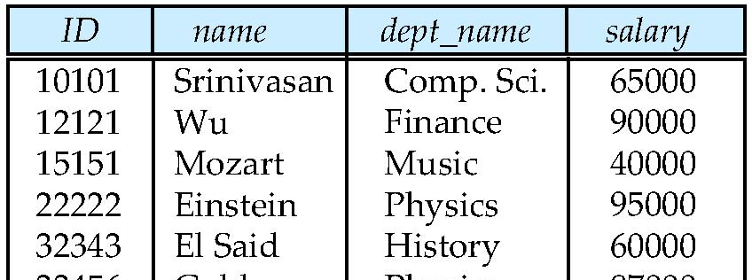
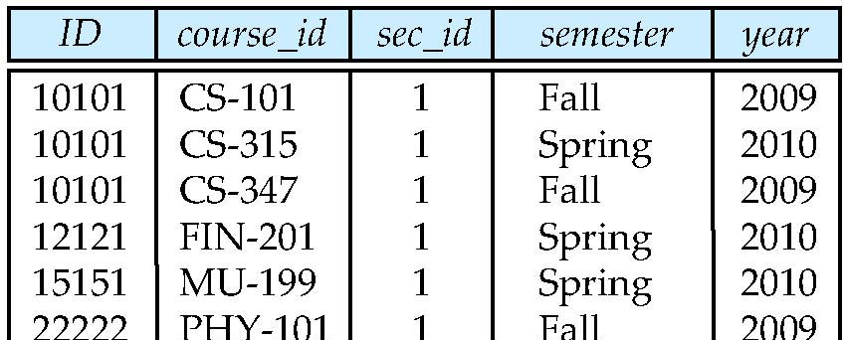
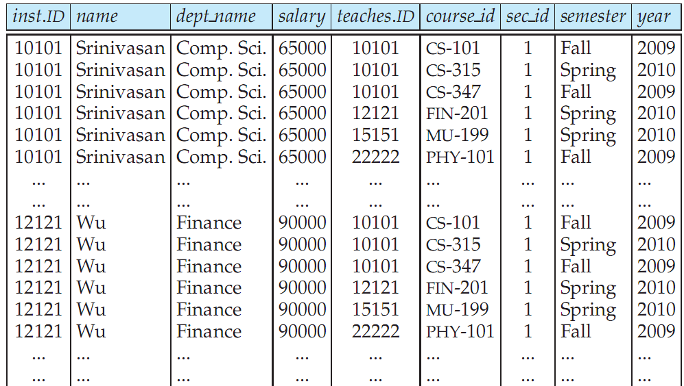
Cartesian Product: instructor X teaches
instructor
teaches

Slide 34
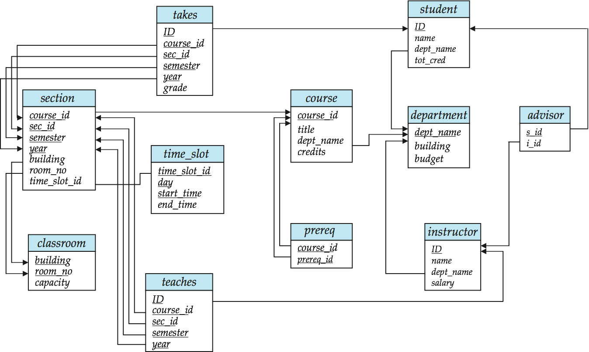
Joins
For all instructors who have taught some course, find their names and the course ID of the courses they taught.
select name, course_id from instructor, teaches where instructor.ID = teaches.ID
Find the course ID, semester, year and title of each course offered by the Comp. Sci. department
select section.course_id, semester, year, title from section, course where section.course_id = course.course_id and dept_name = ‘Comp. Sci.'

Slide 35
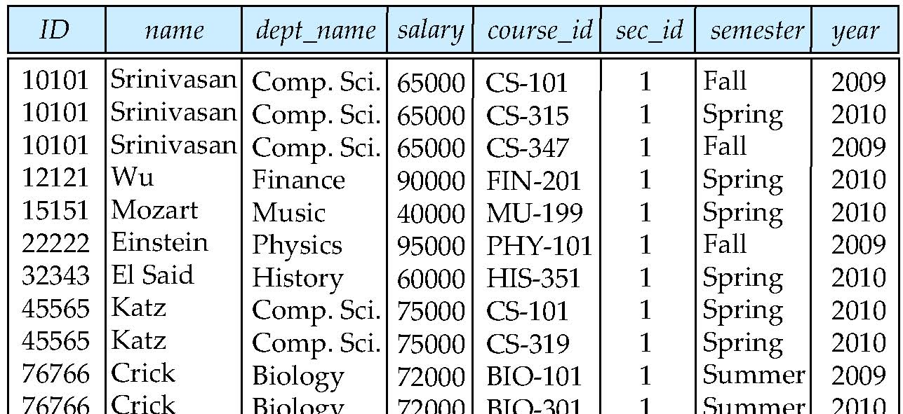
Natural Join
Natural join matches tuples with the same values for all common attributes, and retains only one copy of each common column
select * from instructor join teaches;

Slide 36
Natural Join Example
List the names of instructors along with the course ID of the courses that they taught.
select name, course_id from instructor, teaches where instructor.ID = teaches.ID;
select name, course_id from instructor natural join teaches;

Slide 37
Natural Join (Cont.)
Danger in natural join: beware of unrelated attributes with same name which get equated incorrectly
List the names of instructors along with the the titles of courses that they teach
Incorrect version (makes course.dept_name = instructor.dept_name)
select name, title from instructor join teaches join course;
Correct version
select name, title from instructor join teaches, course where teaches.course_id = course.course_id;

Slide 38
The Rename Operation
The SQL allows renaming relations and attributes using the as clause:
old-name as new-name
E.g.
select ID, name, salary/12 as monthly_salary from instructor
Find the names of all instructors who have a higher salary than some instructor in ‘Comp. Sci’.
select distinct T. name from instructor as T, instructor as S where T.salary > S.salary and S.dept_name = ‘Comp. Sci.’
Keyword as is optional and may be omitted instructor as T ≡ instructor T
Notes:
9

Slide 39
String Operations
SQL includes a string-matching operator for comparisons on character strings. The operator “like” uses patterns that are described using two special characters:
percent (%). The % character matches any substring.
underscore (_). The _ character matches any character.
Find the names of all instructors whose name includes the substring “dar”. select name from instructor where name like '%dar%'
Match the string “100 %”
like ‘100 \%' escape '\'

Slide 40
String Operations (Cont.)
Patters are case sensitive.
Pattern matching examples:
‘Intro%’ matches any string beginning with “Intro”.
‘%Comp%’ matches any string containing “Comp” as a substring.
‘_ _ _’ matches any string of exactly three characters.
‘_ _ _ %’ matches any string of at least three characters.
SQL supports a variety of string operations such as
concatenation (using “||”)
converting from upper to lower case (and vice versa)
finding string length, extracting substrings, etc.

Slide 41
Ordering the Display of Tuples
List in alphabetic order the names of all instructors select distinct name from instructor order by name
We may specify desc for descending order or asc for ascending order, for each attribute; ascending order is the default.
Example: order by name desc
Can sort on multiple attributes
Example: order by dept_name, name

Slide 42
Where Clause Predicates
SQL includes a between comparison operator
Example: Find the names of all instructors with salary between $90,000 and $100,000 (that is, ≥ $90,000 and ≤ $100,000)
select name from instructor where salary between 90000 and 100000
Tuple comparison
select name, course_id from instructor, teaches where (instructor.ID, dept_name) = (teaches.ID, ’Biology’);
Notes:
7

Slide 43
Duplicates
In relations with duplicates, SQL can define how many copies of tuples appear in the result.
Multiset versions of some of the relational algebra operators – given multiset relations r₁ and r₂:
1. σ_{θ} (r₁): If there are c₁ copies of tuple t₁ in r₁, and t₁ satisfies selections σ_{θ,}, then there are c₁ copies of t₁ in σ_{θ} (r₁).
2. Π_{A} (r ): For each copy of tuple t₁ in r₁, there is a copy of tuple Π_{A} (t₁) in Π_{A} (r₁) where Π_{A} (t₁) denotes the projection of the single tuple t₁.
3. r₁ x r₂ : If there are c₁ copies of tuple t₁ in r₁ and c₂ copies of tuple t₂ in r₂, there are c₁ x c₂ copies of the tuple t₁. t₂ in r₁ x r₂

Slide 44
Duplicates (Cont.)
Example: Suppose multiset relations r₁ (A, B) and r₂ (C) are as follows:
r₁ = {(1, a) (2,a)} r₂ = {(2), (3), (3)}
Then Π_{B}(r₁) would be {(a), (a)}, while Π_{B}(r₁) x r₂ would be
{(a,2), (a,2), (a,3), (a,3), (a,3), (a,3)}
SQL duplicate semantics:
select A₁,, A₂, ..., A_{n} from r₁, r₂, ..., r_{m} where P
is equivalent to the multiset version of the expression:

Slide 45
Set Operations
Find courses that ran in Fall 2009 or in Spring 2010
(select course_id from section where sem = ‘Fall’ and year = 2009) union (select course_id from section where sem = ‘Spring’ and year = 2010)
Find courses that ran in Fall 2009 and in Spring 2010
(select course_id from section where sem = ‘Fall’ and year = 2009) intersect (select course_id from section where sem = ‘Spring’ and year = 2010)
Find courses that ran in Fall 2009 but not in Spring 2010
(select course_id from section where sem = ‘Fall’ and year = 2009) except (select course_id from section where sem = ‘Spring’ and year = 2010)

Slide 46
Set Operations
Set operations union, intersect, and except
Each of the above operations automatically eliminates duplicates
To retain all duplicates use the corresponding multiset versions union all, intersect all and except all. Suppose a tuple occurs m times in r and n times in s, then, it occurs:
m + n times in r union all s
min(m,n) times in r intersect all s
max(0, m – n) times in r except all s

Slide 47
Null Values
It is possible for tuples to have a null value, denoted by null, for some of their attributes
null signifies an unknown value or that a value does not exist.
The result of any arithmetic expression involving null is null
Example: 5 + null returns null
The predicate is null can be used to check for null values.
Example: Find all instructors whose salary is null.
select name from instructor where salary is null

